Slide 1


UNIVERSITY INSTITUTE OF COMPUTING
MASTER OF COMPUTER APPLICATIONS(AI & ML)
DATA ANALYTICS
23CAH-721
Prepared By
Rajat Kapoor 23MCI10069
UNIT-1
DISCOVER . LEARN . EMPOWER

Slide 2
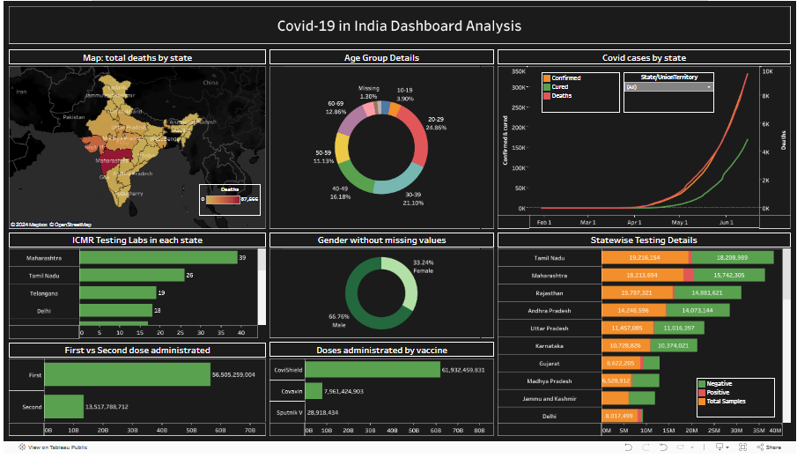
COVID-19 Dashboard: Tableau Visualization
Welcome to the presentation about the COVID-19 Dashboard, a comprehensive visualization tool built using Tableau. This dashboard provides insightful data analysis on global COVID-19 trends and helps to understand the evolving situation.

Slide 3

Introduction and Project Objectives
1
Project Goal
2
Target Audience
3
Key Objectives
Develop a user-friendly dashboard to visualize real-time COVID-19 data, offering a clear and interactive understanding of the global pandemic.
Public health officials, researchers, and the general public seeking accurate and accessible information about the pandemic's progress.
Provide clear and engaging visual representations of key metrics, enabling users to gain insights into the spread, impact, and trends of the virus.

Slide 4

Data Sources & Download Process
1
Data Sources
The dashboard utilizes publicly available datasets from reputable organizations such as the World Health Organization (WHO) and Johns Hopkins University.
2
Data Download
Automated scripts were developed to download and update the data regularly, ensuring the dashboard displays the most current information.
3
Data Cleaning & Preparation
Data cleaning and transformation processes were implemented to ensure consistency, accuracy, and readability of the information presented in the dashboard.

Slide 5
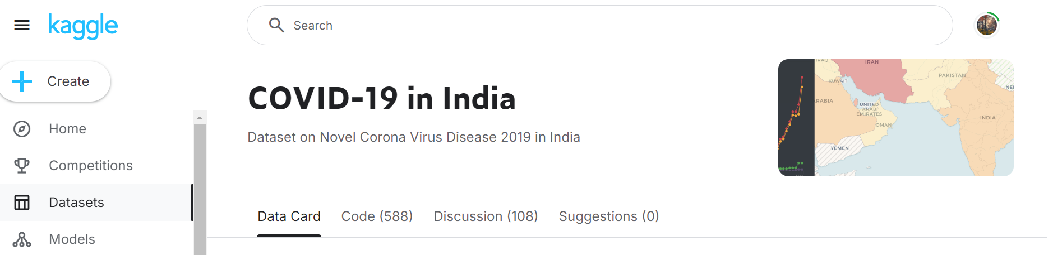
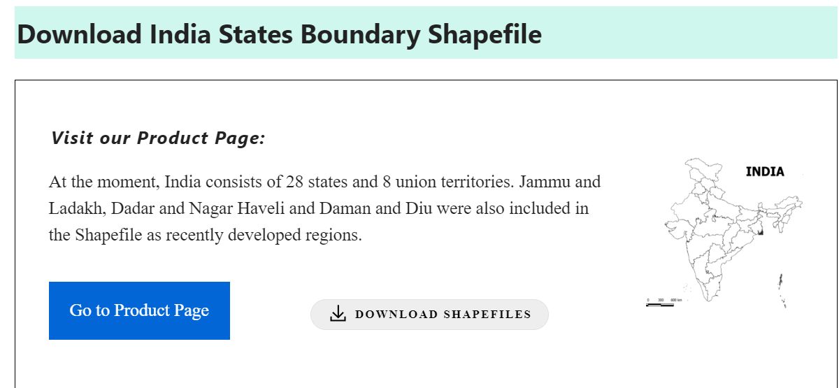

Slide 6
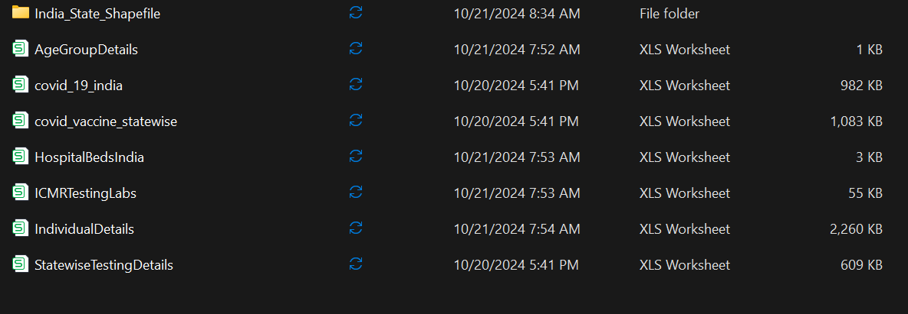

Slide 7
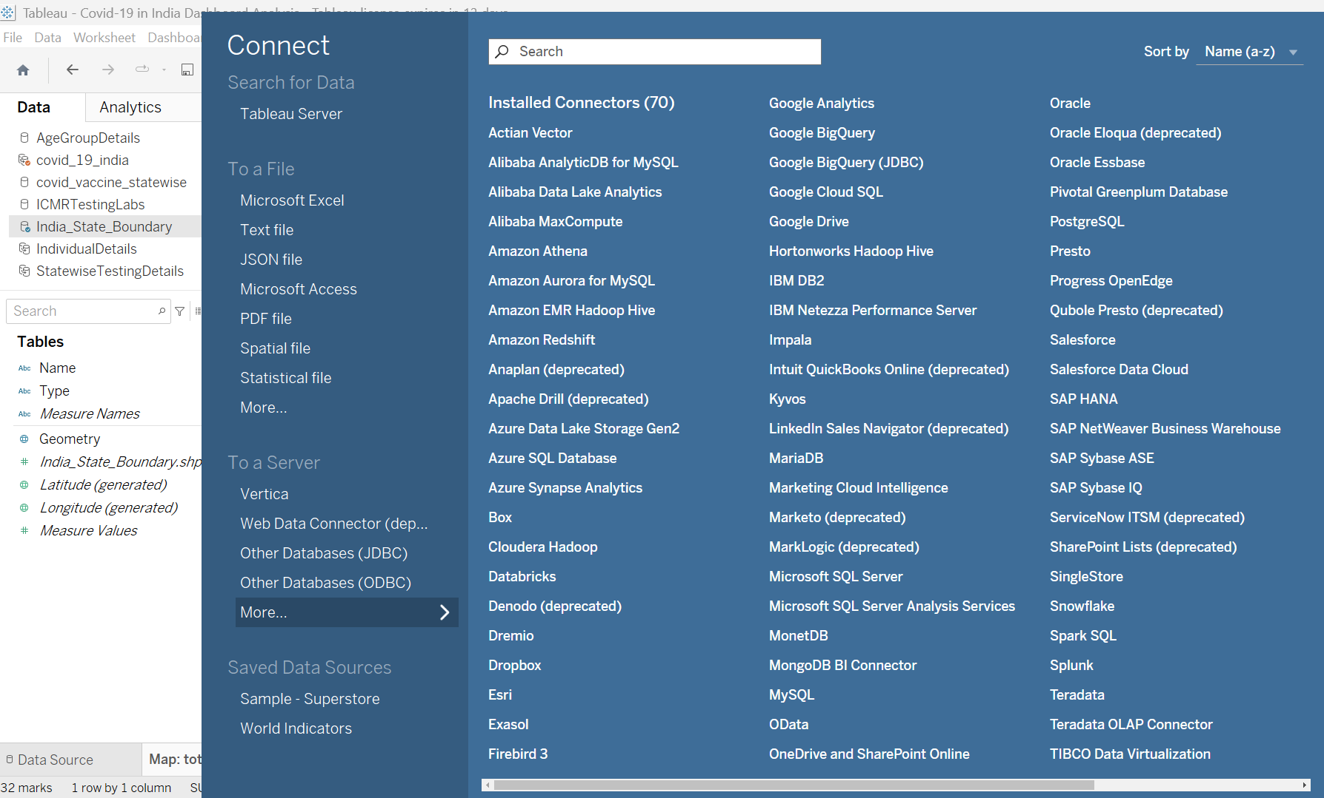

Slide 8
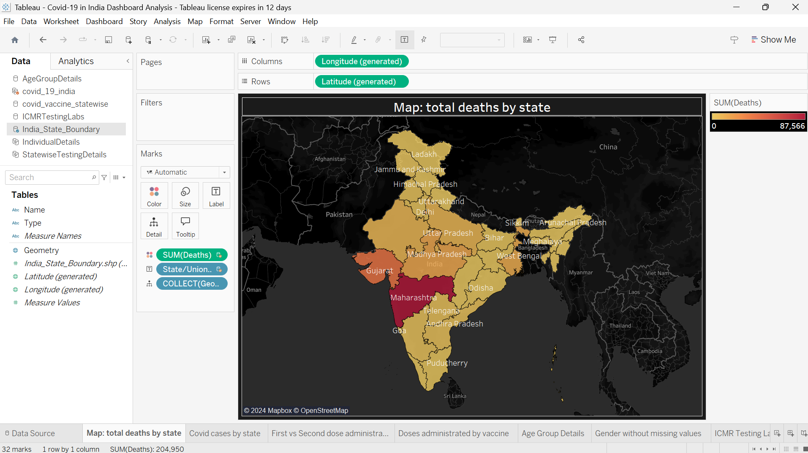

Slide 9
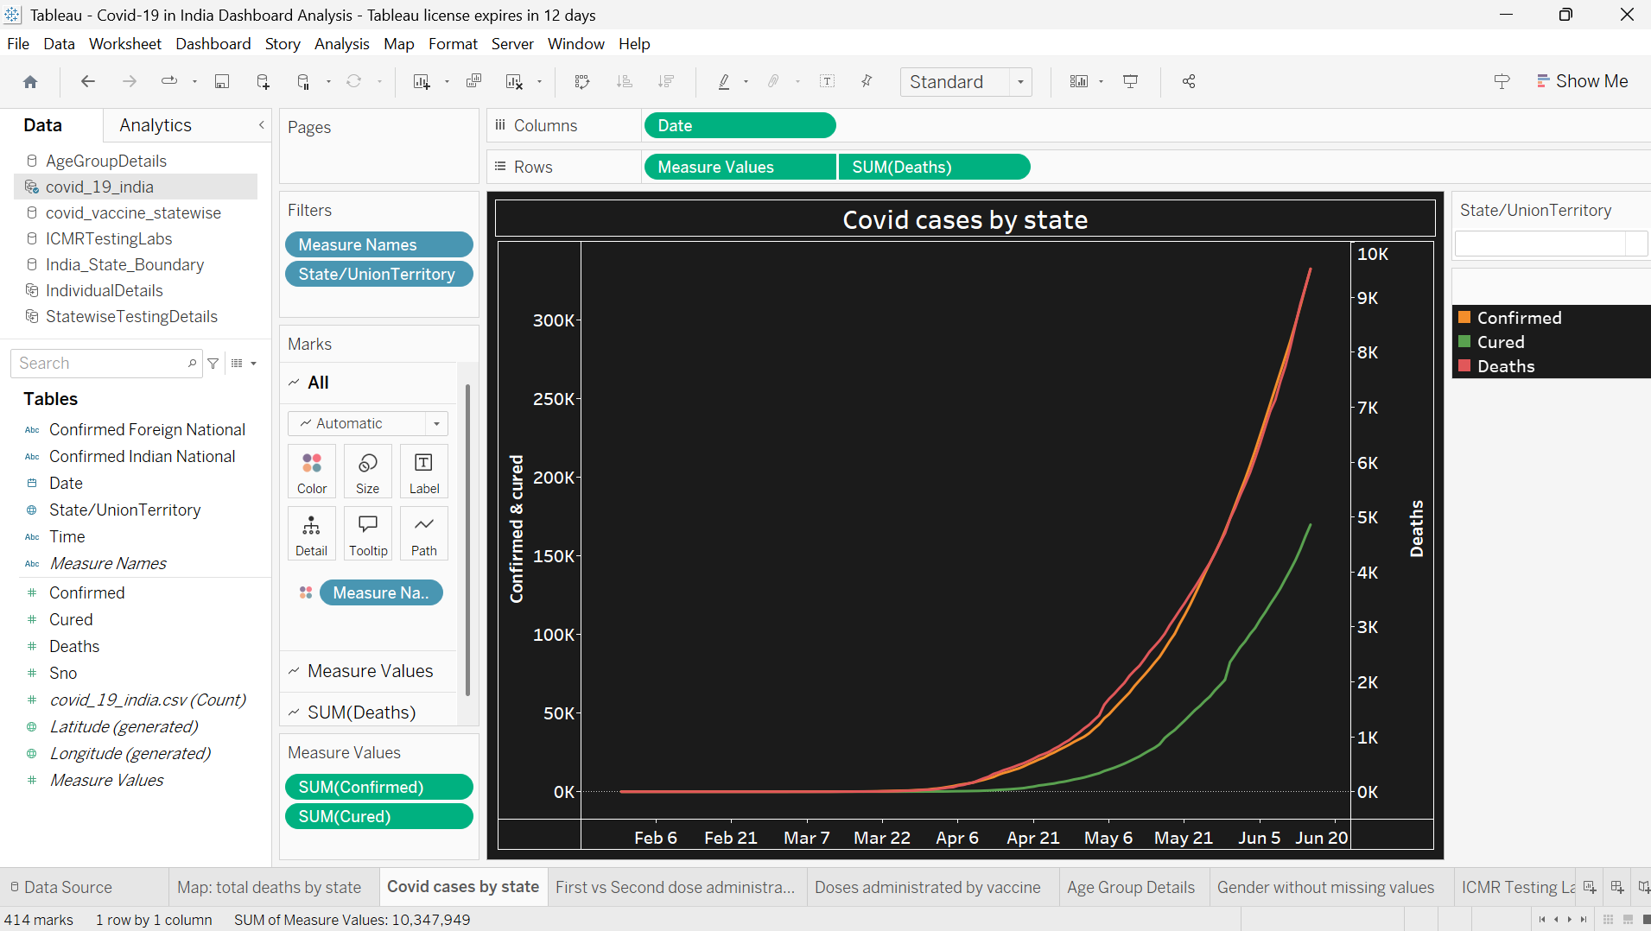
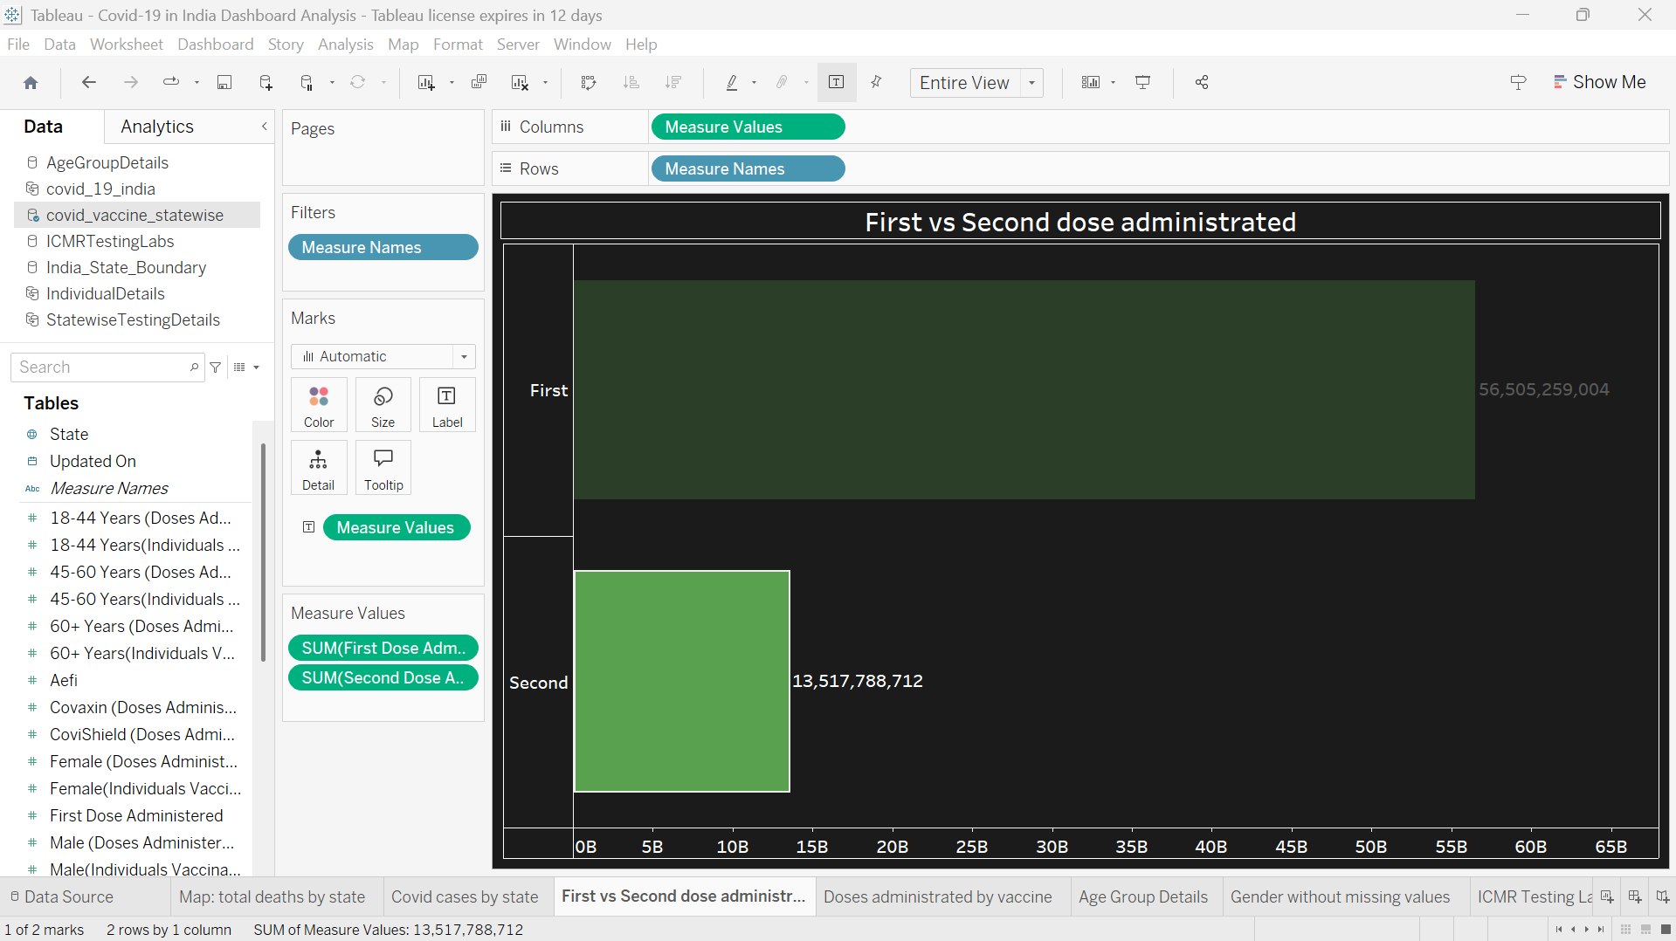
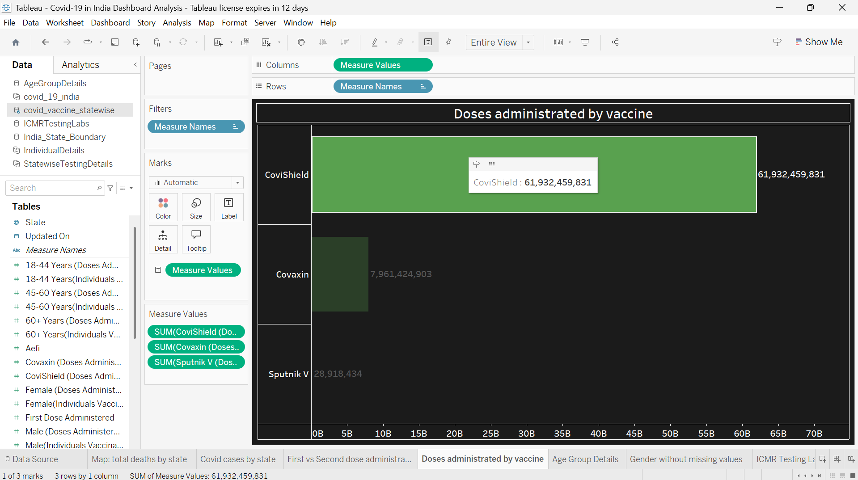
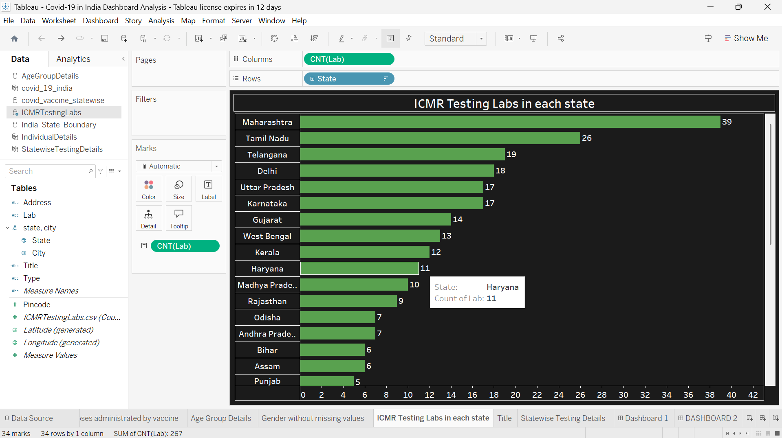

Slide 10
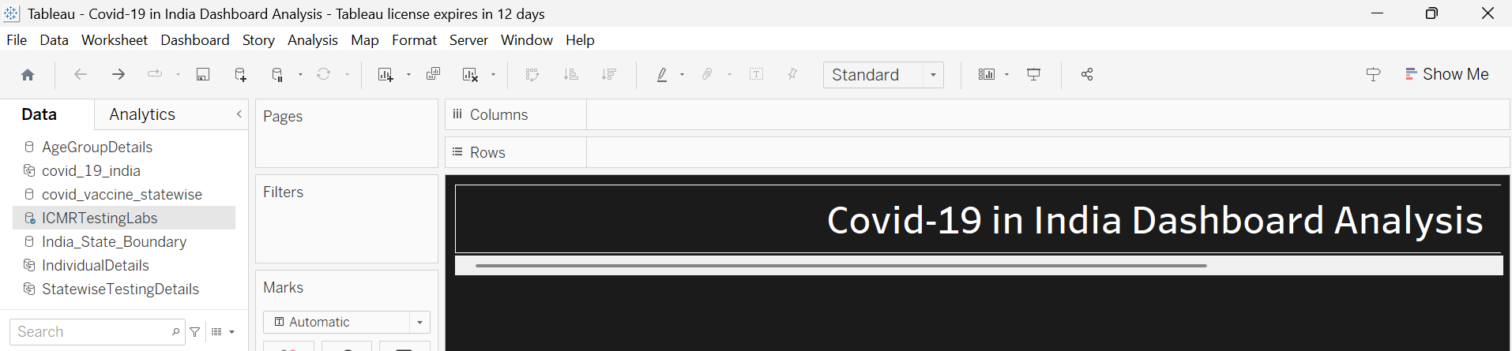
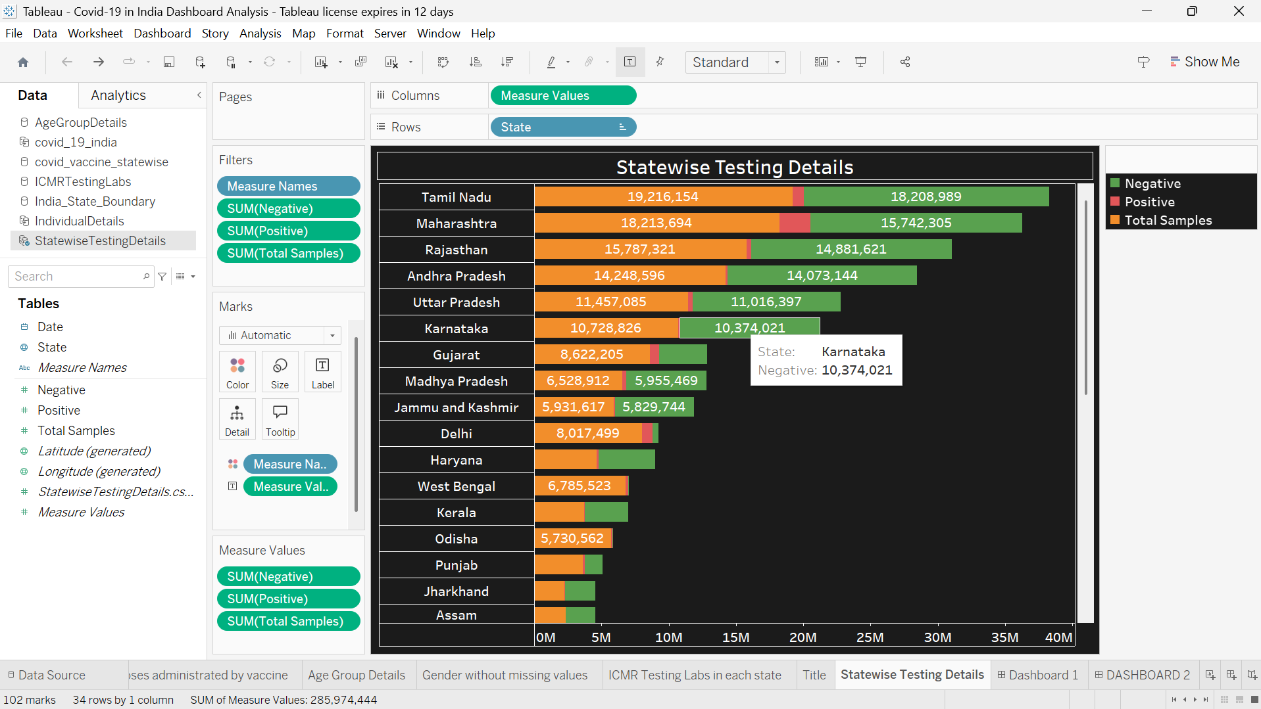

Slide 11
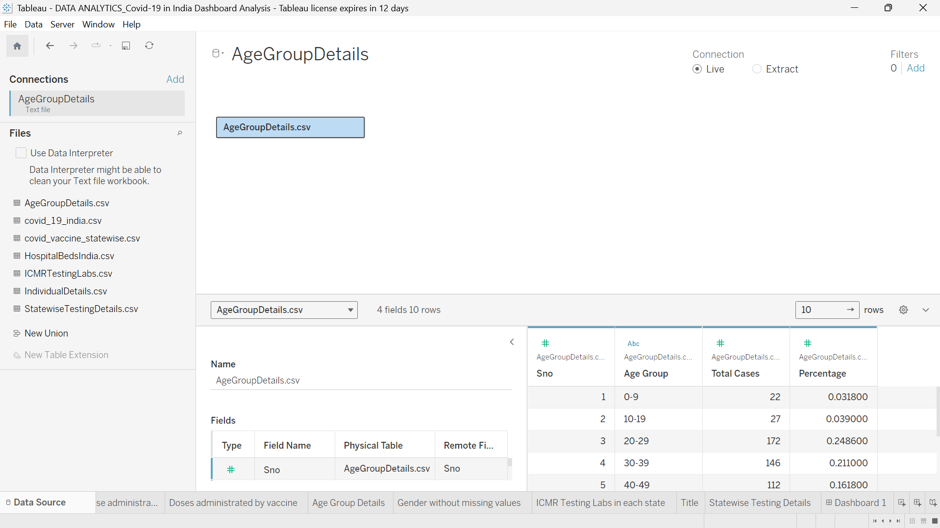

Slide 12
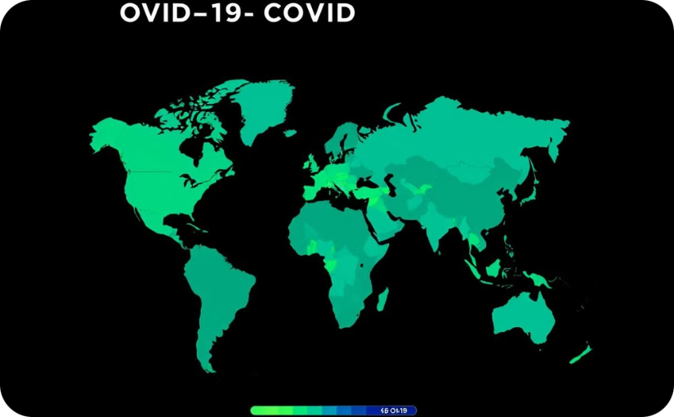
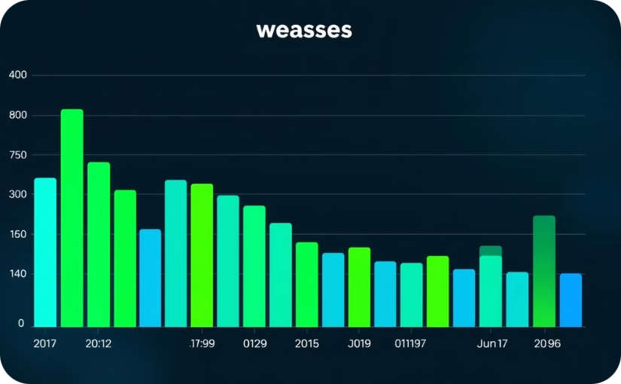
Key Metrics and Map Visualization
Global Case Distribution
Daily New Cases
The map highlights the geographical spread of COVID-19 cases, providing a visual representation of the pandemic's global impact.
Displays the daily number of new COVID-19 cases across the globe, allowing users to track the pandemic's progression over time.

Slide 14

Insights and Common Questions Addressed
Case Trends
Vaccination Rates
The dashboard allows users to explore case trends over time, providing insights into the pandemic's peaks and troughs, and potential factors contributing to these trends.
The dashboard analyzes vaccination rates across different regions, highlighting the relationship between vaccination coverage and COVID-19 case numbers.
Impact on Healthcare Systems
Users can examine the strain on healthcare systems, comparing hospitalizations and ICU capacity across different regions to understand the pandemic's burden on healthcare infrastructure.

Slide 15
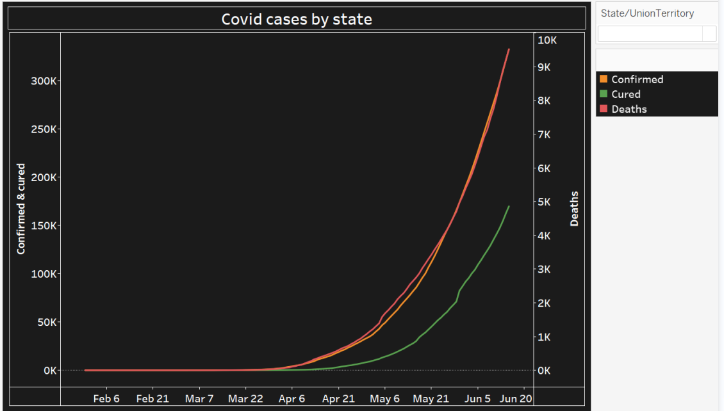
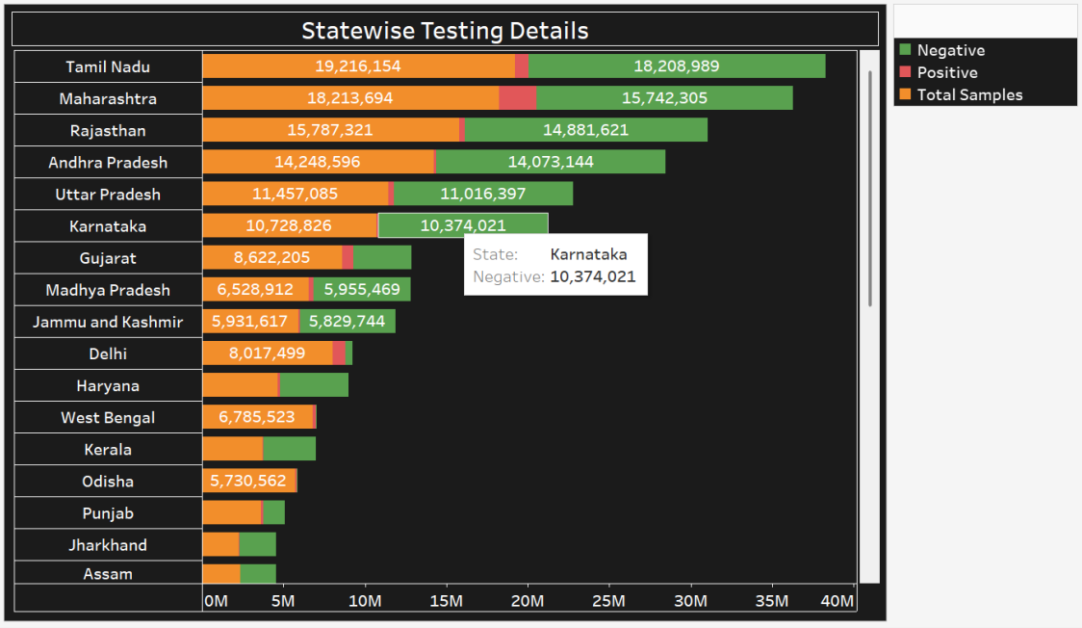
Multiple Line Chart and Horizontal Bar Charts
Case Trends over Time
Comparison of Key Metrics
Line charts visualize the trend of confirmed cases, deaths, and recoveries over time, allowing users to identify patterns and understand the pandemic's evolution.
Horizontal bar charts provide a visual comparison of key metrics, such as case fatality rate, testing rate, and vaccination coverage across different regions.

Slide 16
Donut Charts
Age Group Details
Gender without missing values
This donut chart shows the distribution of COVID-19 vaccinations across different age groups. It highlights the proportion of doses administered to each age category, helping to understand which age groups have the highest and lowest vaccination coverage. This visualization provides quick insights into the demographic impact of the vaccination drive.
This donut chart illustrates the gender-wise distribution of COVID-19 vaccinations, excluding any missing values. It provides a clear breakdown of doses administered to male and female individuals, helping to understand the gender balance in the vaccination process.

Slide 17
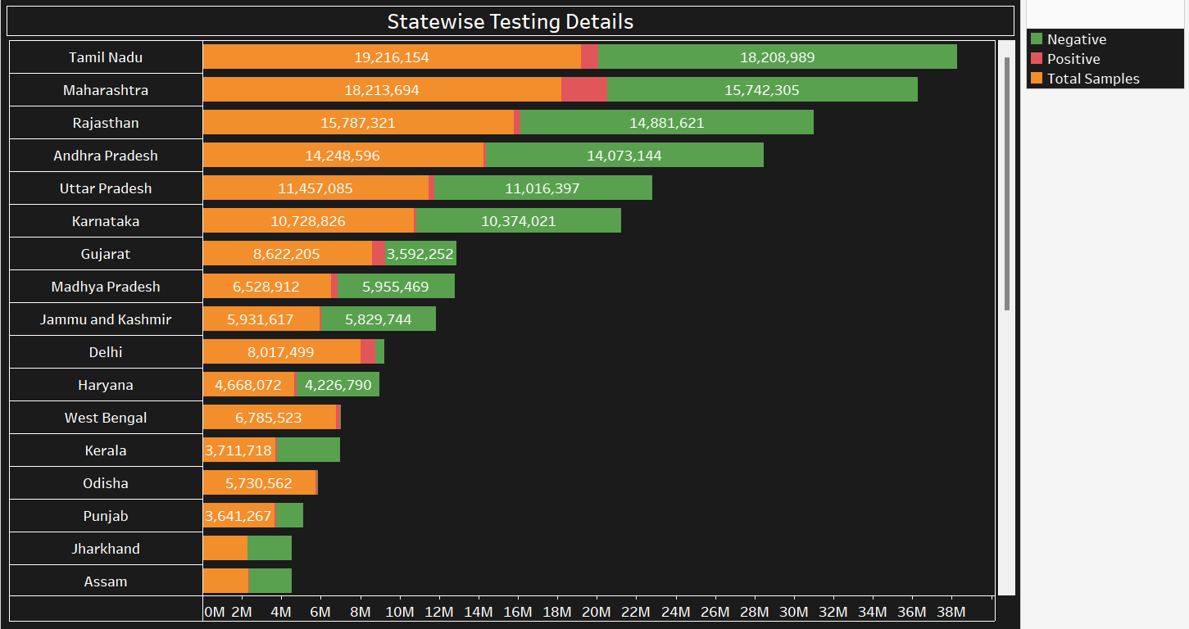
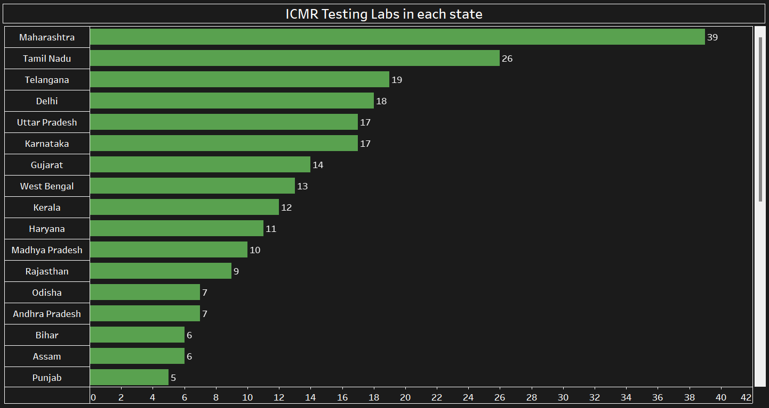
Bar Chart
Statewise Testing Details :
This bar chart displays COVID-19 testing data for each state, showing the number of Negative, Positive, and Total Samples Tested. It provides a clear comparison of test outcomes, helping to understand the testing distribution and positive case trends across states.
ICMR Testing Labs in Each State
This chart shows the distribution of ICMR testing labs across different states. It highlights the number of labs available in each state, providing insights into the testing infrastructure and capacity for handling COVID-19 cases.

Slide 18
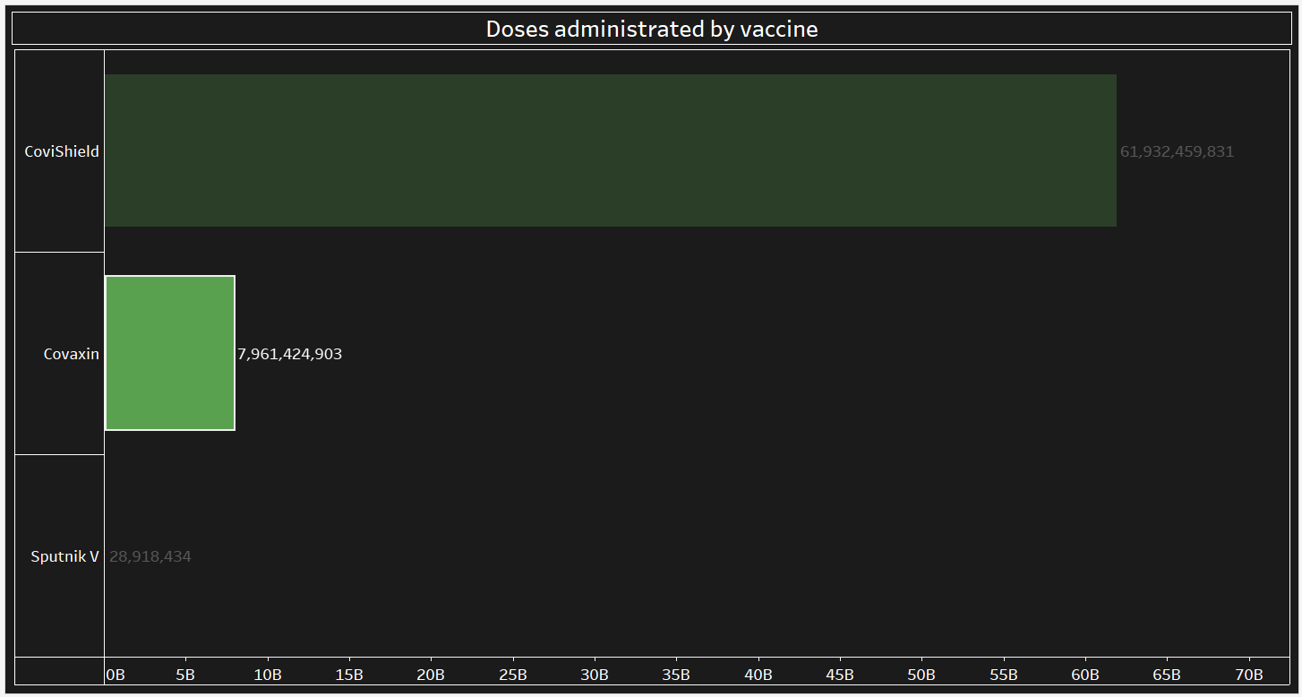
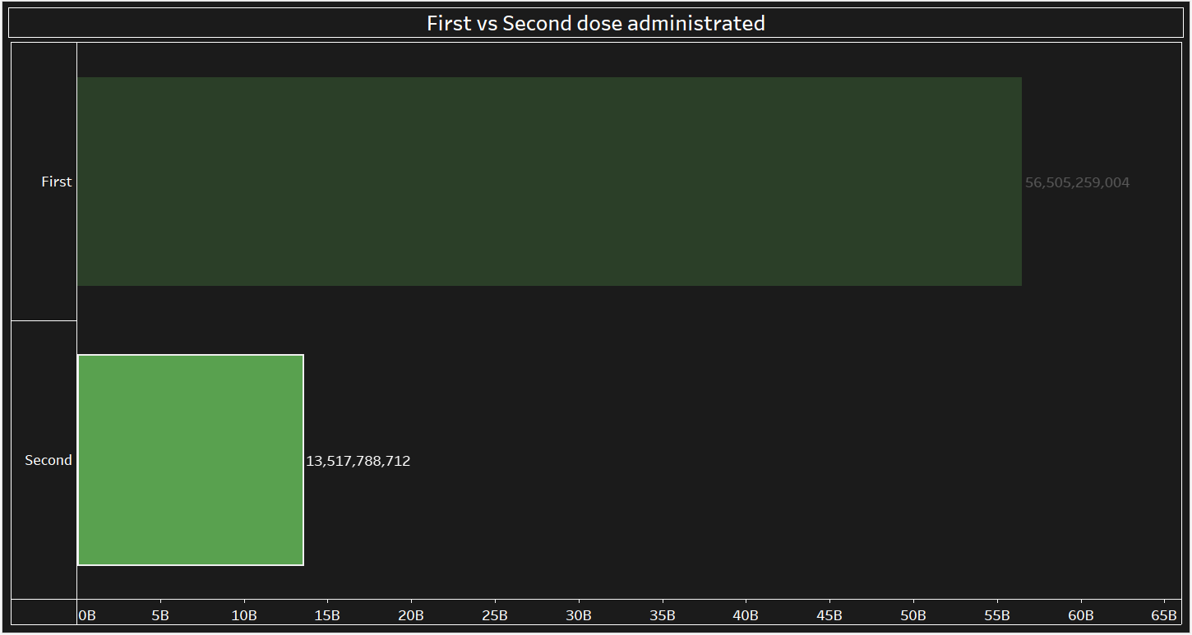
Bar Chart
Doses Administered by Vaccine
This bar chart illustrates the total number of doses administered for three vaccines: Covishield, Covaxin, and Sputnik V. It provides a comparison of the vaccination efforts across these vaccines, highlighting their individual contributions to the overall immunization campaign.
First vs Second dose administrated
This bar chart compares the total number of first and second doses administered during the COVID-19 vaccination campaign. It visually represents the progress in both initial vaccinations and follow-up doses, showing the overall vaccination coverage and completion rates across the population.

Slide 19
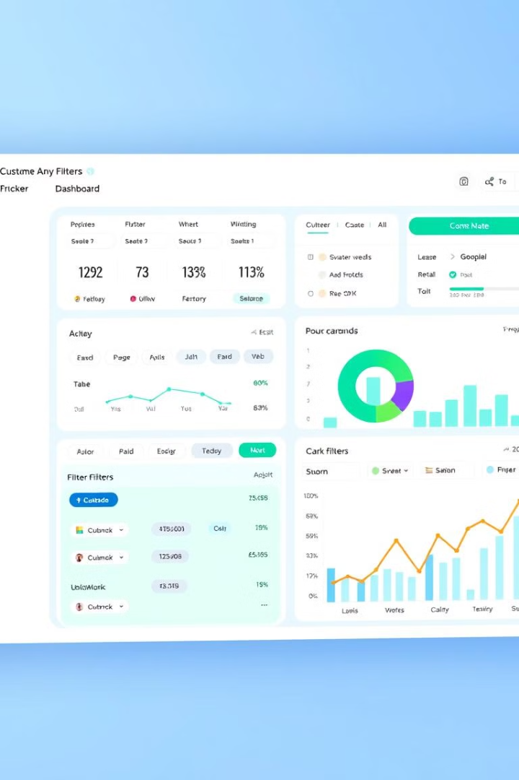



Final Dashboard and User Interaction Features
Interactive Filters
The dashboard allows users to filter data by country, region, date range, and other parameters, enabling customized analysis and exploration of specific trends.
Data Drill-Down
Users can drill down into specific regions or data points to gain a more granular understanding of the pandemic's local impact.
Data Export Options
Users can export data in various formats for further analysis, enabling in-depth research and collaboration.

Slide 20
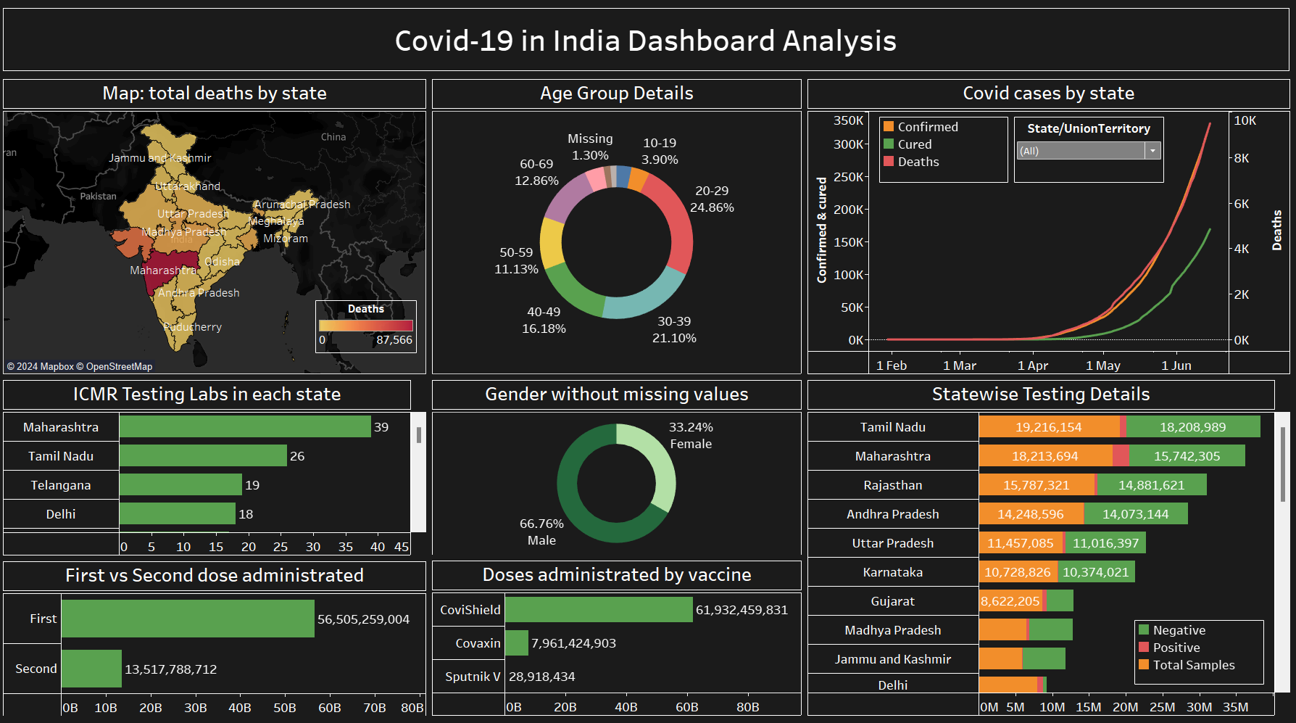

Slide 21

Use Cases and Real-Time Data
Public Health Officials
Track case trends, identify hotspots, and allocate resources effectively.
Researchers
Analyze data to understand the virus's spread and impact on different populations.
General Public
Stay informed about the pandemic's progress and make informed decisions about their health and safety.

Slide 22

Conclusion and Q&A
The COVID-19 Dashboard provides a powerful tool for understanding the global pandemic. Its intuitive interface and comprehensive data visualizations enable users to gain insights into the spread, impact, and trends of the virus. We are continuously working to improve the dashboard and add new features to enhance its functionality. Thank you for your time, and we are happy to answer any questions you may have.

